Slide 1
International Taxation and Base Erosion and Profit Shifting (BEPS)
Sebastian James
Ana Cebreiro
The World Bank

Slide 2

How much is at stake?
Some “guestimates”:
$7 Tn of global assets held offshore (Owens, 2014; Zucman 2015).
$40 –70 Bn of non-taxation of investment income offshore of the US (Guttentag & Avi-Yonah, 2005; Gravelle, 2015).
$ 90- $130 Bn Revenue losses from corporate profit shifting in the US (Gravelle, 2015; Zucman 2015).
$100 Bn trade mispricing in developing countries (Hollingshead, 2010).
$15.42 bn transfer pricing adjustments made by India during 2008-2012 (IFC 2014).
30% of financial wealth of Africa is located offshore (Zucman 2015).

Slide 3
How much is at stake?
A 10% point decrease in a country’s tax rate (e.g. 35% → 25%) → an increase in reported income of:
Study | % | e.g. from | to
Hines and Rice (1994) | 22.5% | $100,000 | $122,500
Huizinga and Laeven(2008) | 13% | $100,000 | $113,000
“Consensus” | 8% | $100,000 | $108,000
Lohseand Riedel (2013) | 4% | $100,000 | $104,000

Slide 4
Key Questions for cross border transactions
What is the appropriate level of taxation that should be levied on income from cross-border transactions?
How are the resulting benefits to be divided among tax jurisdictions?

Slide 5
Central problem on international taxation
Tax authorities of sovereign countries claim jurisdiction over international trade transactions.
• Tax jurisdiction is generally based on nationality / citizenship or territoriality. Rationale: Connection (legal or factual) between the taxpayer and the country.
• Potential double taxation: Conflicting jurisdictional claims. Residence vs Source country.
How to solve it?
• Unilateral domestic legislation
• Bilateral tax treaties
• International harmonization and cooperation

Slide 6
International Tax Principles
Since the 1920s, two general principles ruled the international tax governance, addressing those 2 questions:
Single Tax Principle - Income subject to tax only once (no less, no more). The initial goal (1920s-onwards) was to avoid double taxation, but the focus has shifted towards avoiding double non-taxation (since 1990s).
Benefit Principle – Residence jurisdiction has the primary right to tax passive income (individuals), whereas source jurisdiction has the primary right to tax active income (corporations)……”first bite of the apple”.

Slide 7
Recent developments undermining key principles
Tax Competition: Higher mobility of capital lead tax jurisdictions to lower tax rates on income earned by foreigners to attract portfolio and direct investment:
Passive Income – abolishment of withholding on portfolio interest in the mid-80s set the trend not to tax interest at source in many countries. Combined with existence of tax heavens, it becomes difficult for resident countries to effectively tax passive income.
Active Income – low or no tax on MNC’s foreign source income because of exemptions / preferential treatment in: residence jurisdiction (deferral of tax until distribution); production jurisdiction (tax heavens, SEZs, etc.); and consumption jurisdiction (no PE with e-commerce).

Slide 8
Recent developments undermining key principles
2. Tax Arbitrage. Transactions designed to take advantage of differences between jurisdictions tax systems (i.e. rates, bases) to achieve 2 non-taxation through profit shifting.
Among others, the following tax planning instruments follow this logic:
transfer pricing,
hybrid entities
inversions,
treaty shopping,
earning stripping,
cross-crediting,
cost-sharing agreements,
double sandwiches

Slide 9
Call for action – a brief story
1995 – OECD Publication of TP Guidelines
1998 – Harmful Tax Competition: An Emerging Global Issue (OECD)
2009 – Global Forum for Transparency and EOI (OECD)
2010 – Foreign Account Tax Compliance Act - FATCA (USA)
2012 – G20 leaders endorsed the mandate to prevent base erosion and profit shifting (BEPS).
2013- G20 leaders empowered the DWG to review BEPS during 2014 to identify issues relevant to LICs.
2014 – Common Reporting Standard (CRS)
2015 - BEPS action plan deadlines (September and December).

Slide 10
CHALLENGES IN ENSURING TAX COMPLIANCE IN AN INTERNATIONAL SETTING
The main role of the Tax Administration is to ensure taxpayers pay their correct tax
In the case of domestic taxpayers earning income and making sales domestically this is not an issue
Problems arise when
Taxpayer is domestic but they earn foreign Income
Taxpayer is foreign but earn income domestically

Slide 11
CHALLENGES IN ENSURING TAX COMPLIANCE IN AN INTERNATIONAL SETTING
If we want to tax a foreign taxpayer who earns income domestically we need to have the law behind us because
A foreign government may claim the same income as being taxable there
The rule that a tax administration uses is the concept called
PERMANENT ESTABLISHMENT
i.e. does the foreign taxpayer have any local presence
A Warehouse?
An Employee who helps with sales ?
A Branch?
If we want to tax the foreign income of a domestic taxpayer
We need to obtain information about the Income from the foreign jurisdiction
We need EXCHANGE OF INFORMATION
Unfortunately, this does not happening in an orderly manner

Slide 12
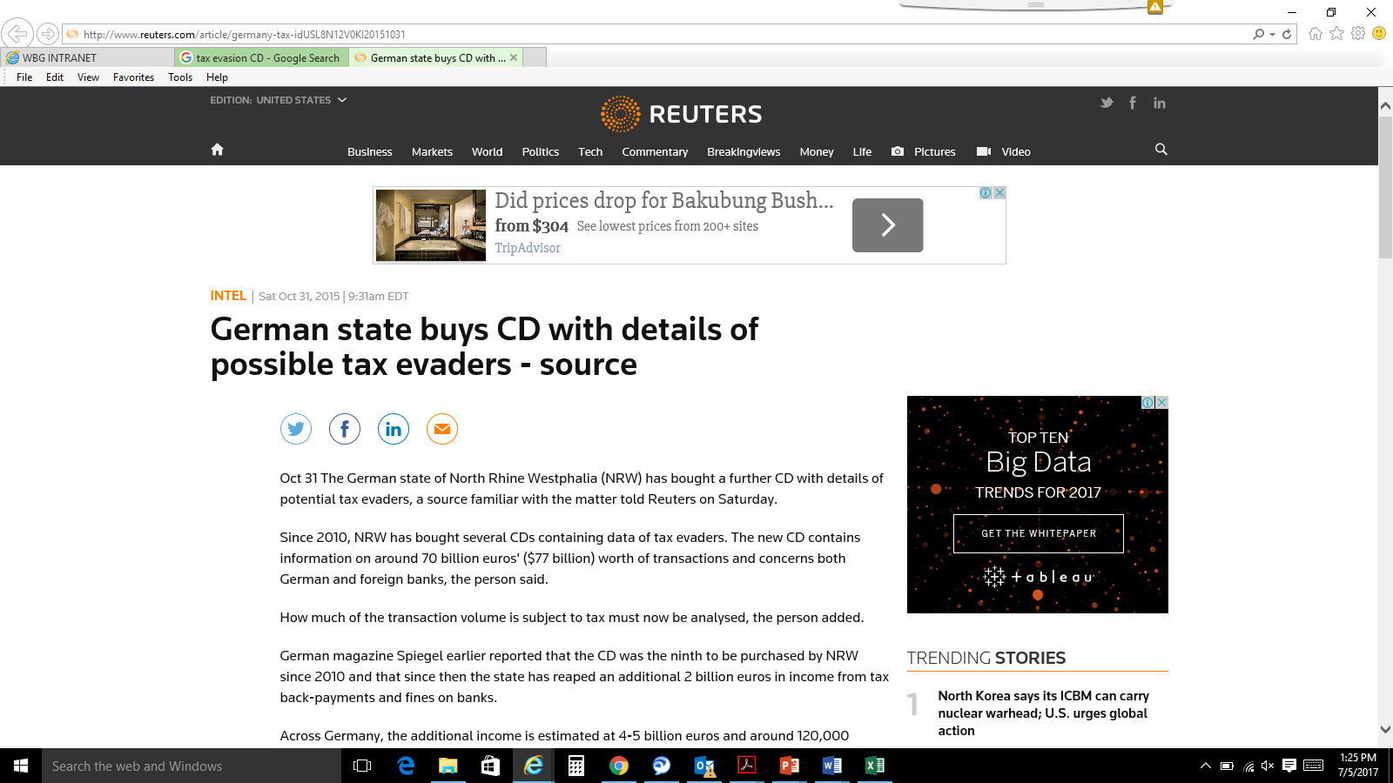

CHALLENGES IN ENSURING TAX COMPLIANCE IN AN INTERNATIONAL SETTING

Slide 13
NEED FOR INFORMATION IN ENSURING TAX COMPLIANCE IN AN INTERNATIONAL SETTING
In the case of Transfer Pricing tax administration needs to know
Whether the parties are related ? (Easy??!!!)
And to calculate the ARMS-LENGTH PRICE we need
Transactions of the Multinational in other countries
Possible tax return information of the taxpayer from other tax administrations
Exchange of information is OK when tax administration knows what to ask for
But “WE DON’T KNOW WHAT WE DON’T KNOW”
We need some kind of “AUTOMATIC REPORTING” of information
COUNTRY BY COUNTRY REPORTING (CbCr) is one such way to obtain information of Multinationals

Slide 14
BASE EROSION & PROFIT SHIFTING
Increase in Cross-border transactions – Unprecedented growth in movement of Capital
Provided opportunity for tax avoidance - Gaps in Intl. tax framework & difference in Tax Policies - exploited by MNEs
Need to control tax base erosion - Geographical barriers less relevance , Intangibles become the value creators, Social behavior of corporates
G20 and OECD joined hands to tackle BEPS - OECD comes out with detailed reports on 15-points Action Plan to revamp international taxation
OECD presented Final Report on October 05 , 2015.

Slide 15
BEPS ACTION PLAN
Pillar | Action | Topic
Digital economy | 1 | Addressing the tax challenges of the digital economy
Coherence | 2 | Neutralising the effects of hybrid mismatch arrangements
 | 3 | Designing effective CFC Rules
 | 4 | Limiting base erosion involving interest deductions and other financial payments
 | 5 | Countering harmful tax practices more effectively, taking into account transparency and substance
Substance | 6 | Preventing Treaty Abuse and Limitation Of Benefits (LOB)
 | 7 | Preventing the artificial avoidance of PE status
 | 8 to 10 | Aligning Transfer Pricing (“TP”) outcomes with value creation
Transparency | 11 | Measuring and monitoring BEPS
 | 12 | Mandatory disclosure rules
 | 13 | TP documentation and CbCR
 | 14 | Making dispute resolution mechanisms more effective
Multilateral Instrument | 15 | Developing a multilateral instrument to modify bilateral tax treaties

Slide 16
BEPS ACTION – I : DIGITAL TRANSACTION
Advancement in Technology – Intangible nature, Service delivery Remotely or Proxy
Location-based service : PE becomes redundant
BEPS Action – I : 3 options
- Nexus of significant economic presence
Withholding on digital transaction,
Equalization Levy

Slide 17
BEPS ACTIONS 2-3-4 : COHERENCE
Effect of Hybrid mismatch- Avoid double non-taxation - Alignment of domestic rules and amending treaties for dual residents entities
CFC Rules – domestic laws amendments , India – GAAR provisions from 1.4.2017
Thin Capitalization Rule -Interest deductible up to 30 % of its earnings EBITDA

Slide 18
BEPS ACTIONS 5-6-7 : SUBSTANCE
Based on Transparency and substance
Substantial Activity Test - Nexus Approach
Preferential treatment-benefits from IP regime
Principal Purpose Test (PPT ) to capture cases designed for tax avoidance
Design Domestic Law to prevent Treaty Benefit -prevent Double Non-Taxation

Slide 19
BEPS ACTIONS 5-6-7 : SUBSTANCE
Provisions to be included in Treaty to avoid Treaty Shopping -Tax Avoidance
Specific Anti-Abuse Rule (LOB Rule )
General Anti-Abuse Rule -GAAR

Slide 20
BEPS ACTIONS 5-6-7 : SUBSTANCE
Prevention of artificial avoidance of PE :
Provision of goods & services - New Defn. of PE
Preparatory & Auxiliary Defn. Expanded
PPT to check artificial PE
Most of the Developing countries follow UN Models- Treaty provisions already exists
Legal Challenges - PE Defn. of OECD Model

Slide 21
BEPS ACTIONS 8-9-10 : TP GUIDANCE
Revision of OECD Guidelines on TP
TP outcomes in line with value creation with regard to Intangibles, risk, capital and other high risk transactions
Legal ownership alone can not seek all returns from exploitation of intangible
FAR analysis of Group companies for allocation of returns
Guidelines does not deal with ‘issue of attribution of profits’ to functioning entities , countries free to determine ALP

Slide 22
ACTION11-12: BEPS Impact Analysis & Disclosures Rule
Impact of BEPS countermeasures thru data analysis
Disclosures of Business Affaires of MNEs
Forms vs Substance
Intrusive Tax Administration – surveys operations
POEM: Key Management & commercial decisions to conduct business determines tax residency
Effects : If MNEs as tax residence, then global income to be taxed @ 40 % if no DDT levied , no set-off of carry forward losses

Slide 23
BEPS Action 13: TP documents & CbCR
Why TP Documentation ?
Tax Payer’s assessment of ALP
TP Risk assessment
TP audit
Problem of BEPS
Absence of Standardized format of reporting
Growing need for enhanced transparency

Slide 24
BEPS Action 13: TP documents & CbCR
Recommendation to establish a three-tier structure of TP documentation- local file, master file and CbCR
OECD model template of CbCR along with detailed instructions;
Implementation challenges and suggestion for possible solutions
CBC reporting – “A tax risk assessment tool”
Notes:
Use multiple points, if necessary.

Slide 25
BEPS Action 13: TP documents & CbCR
Master File – MNE group’s organizational structure , MNEs business description , MNEs intangibles , MNEs intercompany financial activities , MNEs financial and Tax position
Local File – Local entity information , Information on controlled transaction ( Inter co agreements, FAR and comparability analysis , most appropriate methods for ALP ) , Financial transaction
CbCR – The CbCR requires aggregate tax jurisdiction-wise information - global allocation of the income, the taxes paid, and certain indicators of the location of economic activity among tax jurisdictions .
Notes:
Use brief bullets and discuss details verbally.

Slide 26
BEPS ACTION-15 : MLI
BEPS implementation – changes required for 3000 bilateral treaties
MLI would swiftly modify all covered bilateral tax treaties (CTA/ Covered Tax Agreements) to implement BEPS
MLI implements two minimum standard
- Prevention of treaty abuse
- Dispute resolution through MAP
MLI- flexibility to exclude specific tax treaty, or to opt out of a provision

Slide 27
BEPS ACTION-15 : MLI contd…
MLI opened for signing-Dec 31,2016
First Joint Signing Ceremony- June 07,2017
MLI becomes binding upon ratification
List of CTA and Reservations to be mentioned during signing ( provisional list) , final list submission by the ratification day.

Slide 28
EXPANSION OF TAX BASE OF – DEVELOPING COUNTRIES
Capacity building of Tax Admn. Official
Tax account no. – Compulsory for all, simplified procedure for allotment
Technology – Enabled monitoring of Transaction
Exchange of information between –
Agencies within a tax jurisdiction
Different tax jurisdictions
Evolving simple but robust withholding tax mechanism
Developing countries- to revisit tax treaty to keep pace with evolving business models – regular interval.

Slide 29
EOI: Global Initiatives against Tax Evasion
Cooperation in Exchange of Information - Legal Instruments
DTAA - where allocation of taxation rights required
TIEA - where no need for taxation rights, only sharing of A/c data
MLA – MCMAA – 85 countries joined for EOI
Global Forum on Tax Transparency (GFT) of OECD - Peer Review to monitor standard of transparency

Slide 30
EOI: Global Initiatives against Tax Evasion
Administrative Assistance in Offshore Tax Jurisdiction to protect tax base
Under Multilateral Legal Agreement :
Exchange of Information
Spontaneous Ex of Information
AEIO (Automatic Ex of Information)
Collection assistance under DTAA (Art. 27 )
Joint Audit – Tax Examination abroad
CRS under GFT prescribed ‘Uniform Standard for Exchange of Information modeled on FATCA’

Slide 31
The Way FORWARD……
International taxation normative represents a long and unfinished effort.
Time to reflect about the current international tax architecture
More than ever, cooperation is the key element of success
Need to strength our analytics to measure the ITX-GAP.
Time to stick back to IT basic principles?

Slide 32
Thank You
sjames2@worldbank.org

